Slide 1


GREEN
Collaborative intelligence for sustainable cities
June 5th,
Flower Monthly

Slide 2




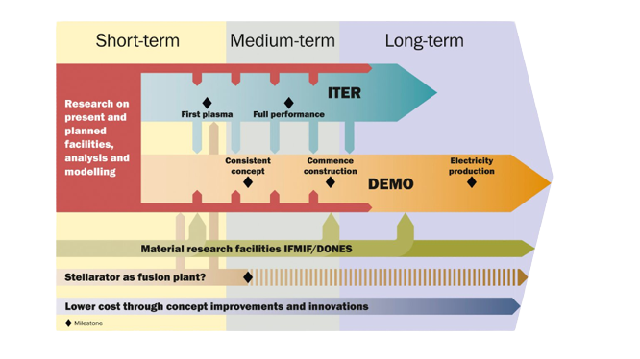

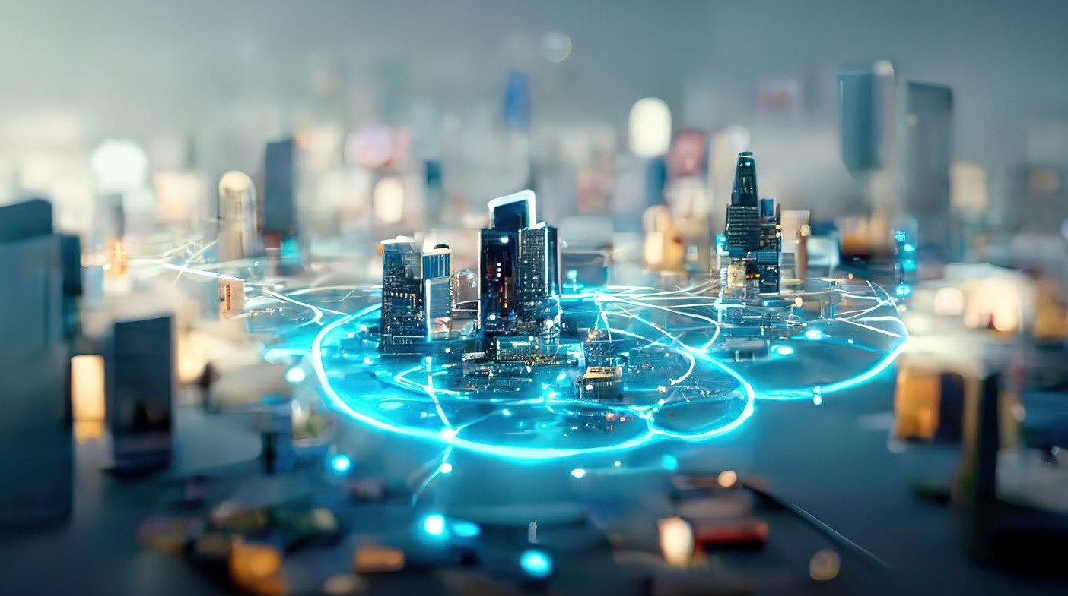











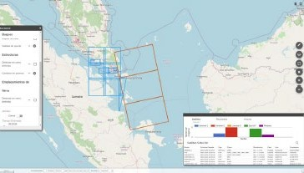
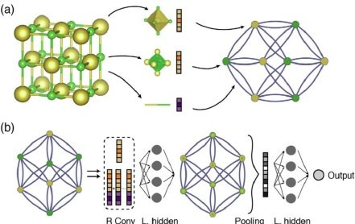

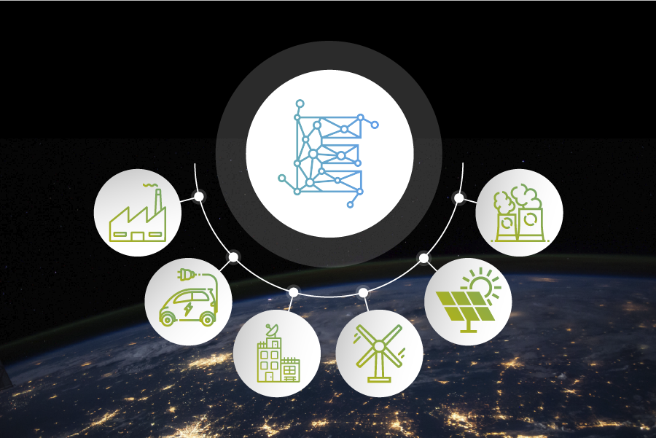

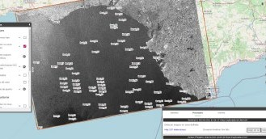

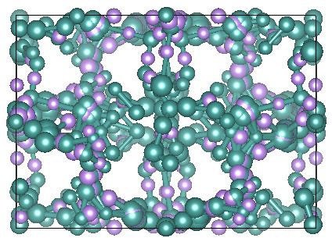

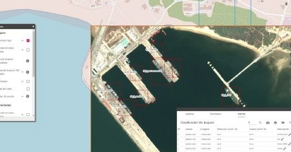






Projects AI · Navy MAPRE · 2021-2023
Projects · Smart Cities GREEN [ 2022-2024]
AI applied to Fusion energy
Industrial technology research project aimed at optimizing the efficiency of a large scientific fusion facility, such as IFMIF-DONES.
Collaborative intelligence for sustainable cities
Industrial AI platform that combines Federated Learning, Blockchain and Smart Contracts technologies. GREEN is an initiative based on both respecting citizens' privacy and optimizing resources, which will make cities more sustainable and accessible for their inhabitants.
Artificial Intelligence Systems for Industrial Process
Application: AI platform for optimizing Smart Contracts (SC) between IoT in a secure way, using Federated Learning (FL) and Blockchain.
Electrolineras Partner: Naturgy
Fusion Power Plants
Naval. Preventive Maintenance
Discovery of new materials. Batteries
Space. Remote sensing
Security. Critical Infrastructures
Health. Remote Monitoring
Energy. Intelligent Energy Networks
Projects AI · Space · SEDA [Satellite Data AI]
Automatic Search for Information in Satellite images and data
using AI
Projects AI · Energy · ENIGMA [Electric Grid AI] · 2020-2022
Projects AI · Materials LiOn-HD
Artificial Intelligence to increase
the efficiency of renewable sources
Creation of new materials
SEDA is the Spanish Defense R&D project whose mission is the automation of satellite data observation. It offers an integrated solution for defense intelligence analysts.
The LiOn-HD project is included in the call of the "Misiones Ciencia e Innovación 2020" program of the Centro para el Desarrollo Tecnológico Industrial (CDTI). It is a project that includes a diverse consortium collaborating to achieve the overall objective: to significantly improve the energy density, reduce the cost and increase the sustainability of lithium-ion batteries.
CGCNN
HI-IBERIA in collaboration with the companies PRYSMA and INGELECTUS proposes a paradigm shift in the control of the electrical system through the use of artificial intelligence methodologies.
Application: AI technologies to search for new cathode materials.
Scientific Partner: Institute of Materials Science of CSIC.
Notes:
HI Iberia is an innovative SME, founded in 1999 and developing artificial intelligence software for the industry.
HI Iberia has now more than 120 professionals, 90% of them are engineers, allowing HI Iberia to have a high level of innovation and interest and capacities in new technologies.
We specialize in creating advanced solutions for critical sectors -> Here you can see some of them
such as energy, collaborating with leaders like Naturgy and Red Eléctrica Española; in the naval category, we work with Navantia and the Spanish Navy; and in security, we develop projects for the Spanish National Police and CESTIC.

Slide 3

Index
Navigating Themes and Sections
Introduction
Presentation of the project and Use Case
Digital Twin
Accurate and up-to-date virtual representation
Results
Outcome-driven metrics and insights
Applicability
Benefits and uses in the field of Industrial
Q
W
D
C
q
t
H
g
Technology Combination
Synergy of cutting-edge technologies
Solution
End-to-end technological response to challenges
Models & Data
Advanced algorithms & training datasets
Conclusions
Discussion of the proposal and its impact

Slide 4

Introduction

Slide 5




The Project Proposal
AI platform at an industrial level to enable the implementation of projects aimed at exploiting IoT data.
GREEN
[inteliGencia colaboRativa para ciudadEs sostENibles]
Smart Cities
Cities that use technology and data to improve the quality of life of their inhabitants and focus on efficiency in the use of resources, sustainability, digital connectivity.
Use Case
Energy demand prediction model, from which charging station managers can negotiate a price adjusted to their needs.
Notes:
Red.es is a public corporate entity under the Ministry of Economic Affairs and Digital Transformation of the Government of Spain.
Specifically, Red.es falls under the State Secretariat for Digitalization and Artificial Intelligence.
Its mission is to execute projects and programs that accelerate the digitalization of Spanish society and the growth of the digital economy.
-------
Naturgy is a leading multinational company in the energy sector, headquartered in Spain,
dedicated to the generation, distribution, and commercialization of electricity and natural gas.
Naturgy operates in more than 20 countries and serves millions of customers in both Europe and Latin America

Slide 6

The Charging Environment
More sustainable and more accessible locations
Network Provider
A company that transports electrical energy, as well as builds and maintains transmission facilities.
Charging Stations (CS)
Infrastructure that links the electricity distribution network and the electric vehicle, in order to carry out the recharging.
CS Managers
Electricity consumer authorized for the supply and resale of electricity.
EV users
Vehicle users run on electricity supplied by rechargeable batteries.

Slide 7
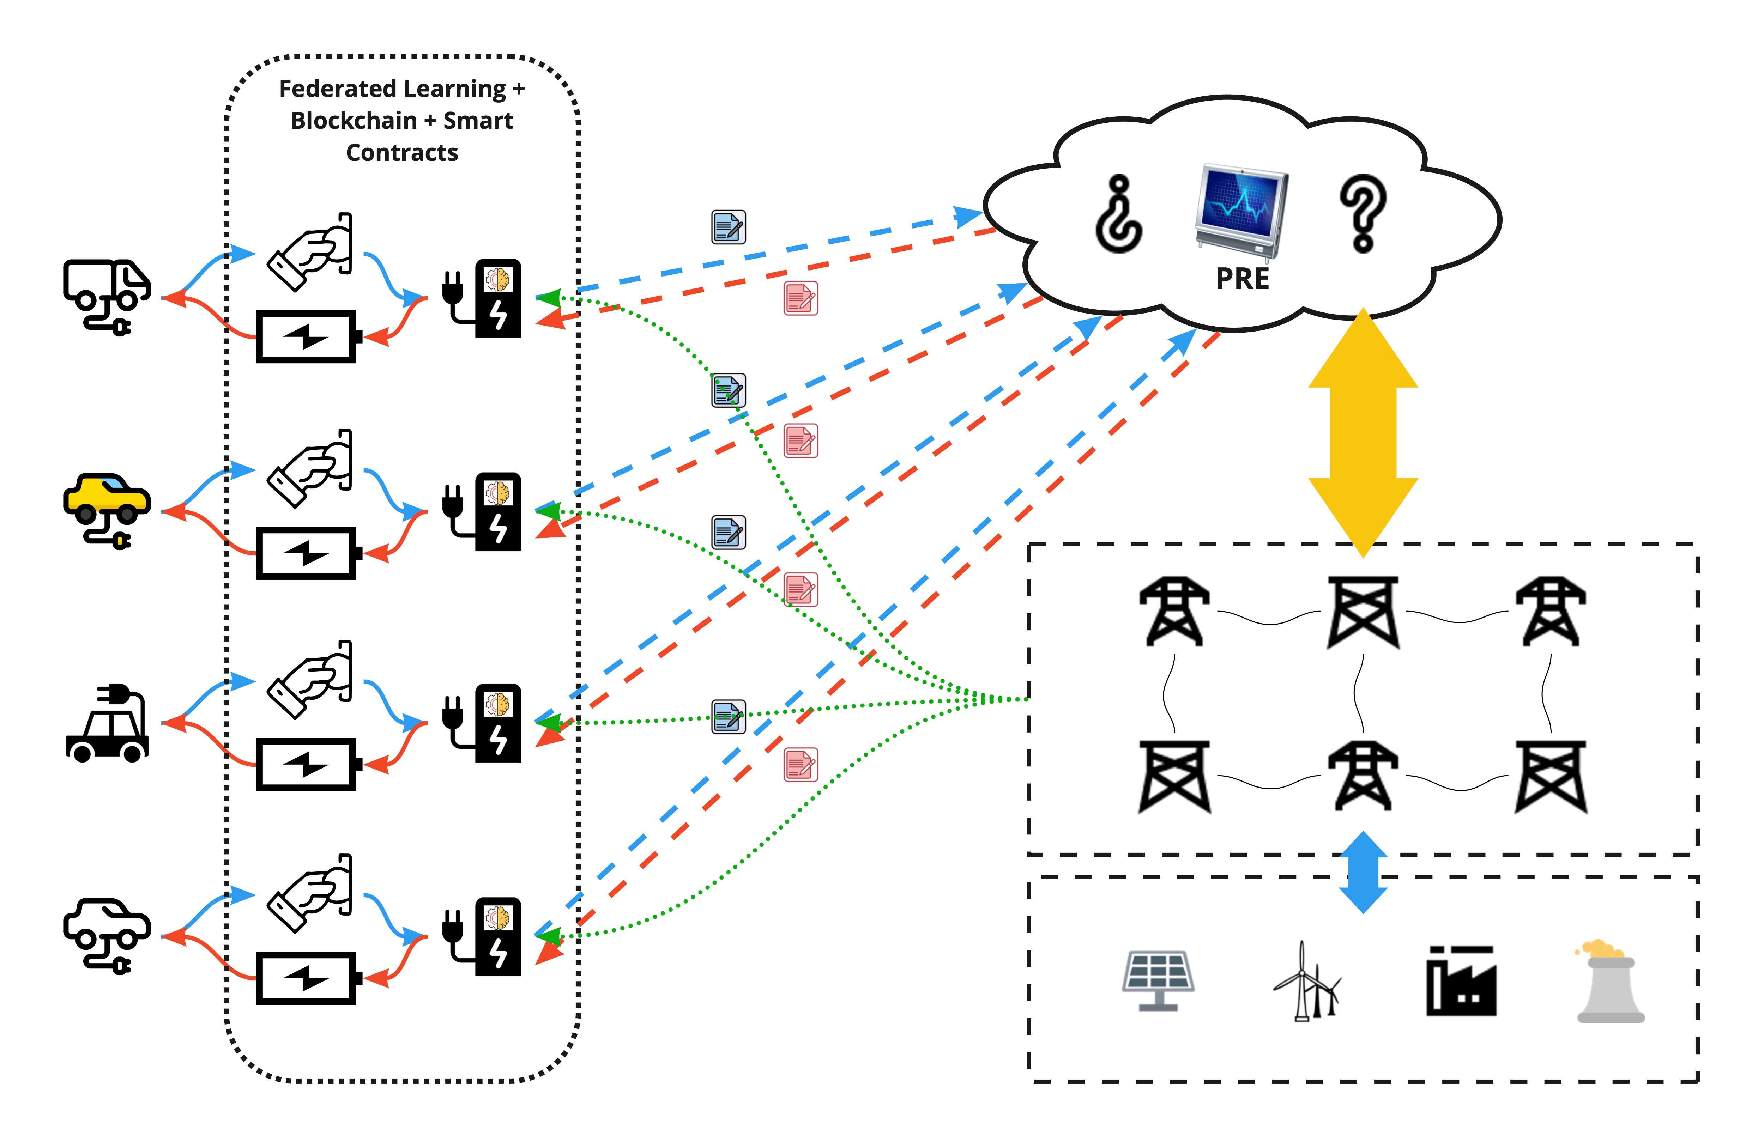
Use Case
Decentralized, secure and transparent EV recharging services
Create a model to predict the energy demand required in the CS, so that the operators of the charging stations (GER) can negotiate a price (optimize SC) adjusted to their needs with the Electricity Grid Provider (PRE)

Slide 8
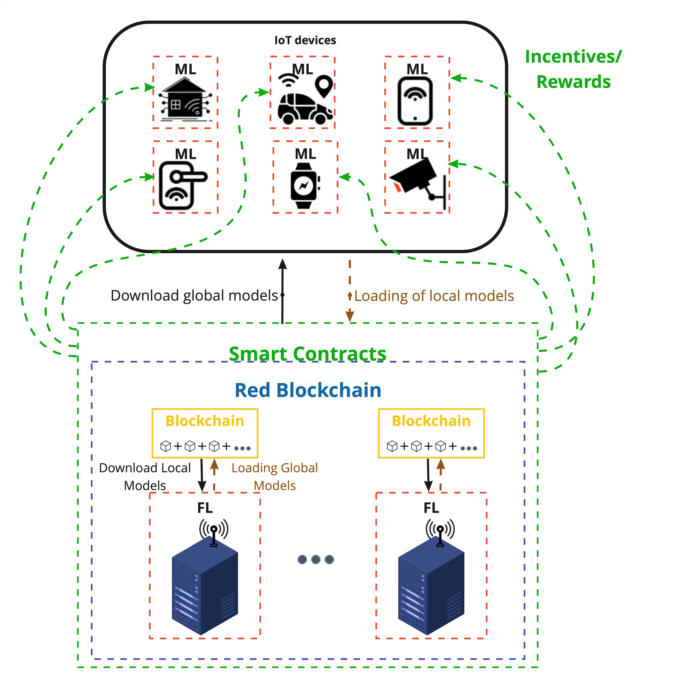
Functional Schematic
Blockchain, Federated learning & Smart contract Technology Scheme
a
IoT Connection
IoT devices store local data and update local models using ML algorithms.
g
Training Process
Local models will be added to create a new global model.
Updated Model
Each of the IoT devices will download the global model and receive a reward based on their contribution.
I

Slide 9
The Solution

Slide 10
Challenges
Solving these challenges is crucial for the industrial development of the future.
&
d
K
Security
Ensuring security and related information is crucial to avoid internal and external threats.
Reliability
Companies are not always interested in sharing their data, as this could mean losing profits when competing.
Decentralization
Centralization can limit a company's agility and innovation capacity, obstructing prompt and customized responses to the dynamic changes.
Main obstacles related to management and improvement in the industrial sector.
01
02
03

Slide 11
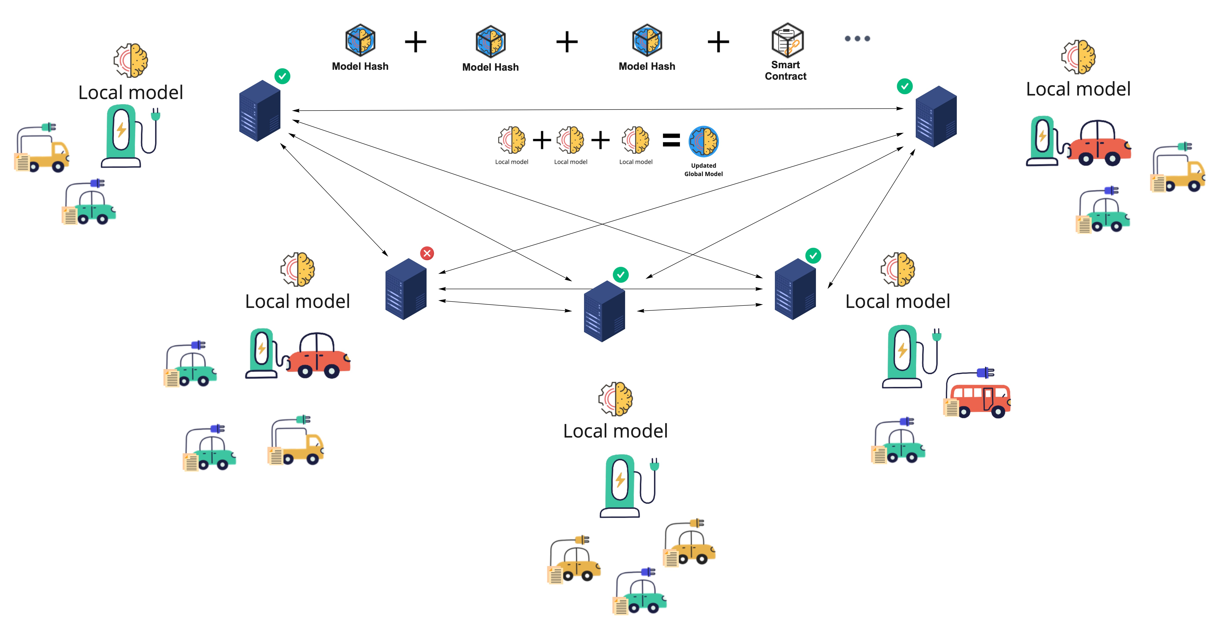
GREEN Network
Federated Learning, Blockchain y Smart Contracts
Federated Learning Architecture It allows different users to collaborate on the creation of global models.
Smart Contracts
They establish immutable and transparent rules that govern the platform
Decentralization of the system
Validation and sharing of local models will be done through the Blockchain network.
Blockchain-as-a-Service
Blockchain service offering that allows services to be used within the network.
GREEN is not simply a solution; it's a transformation.

Slide 12


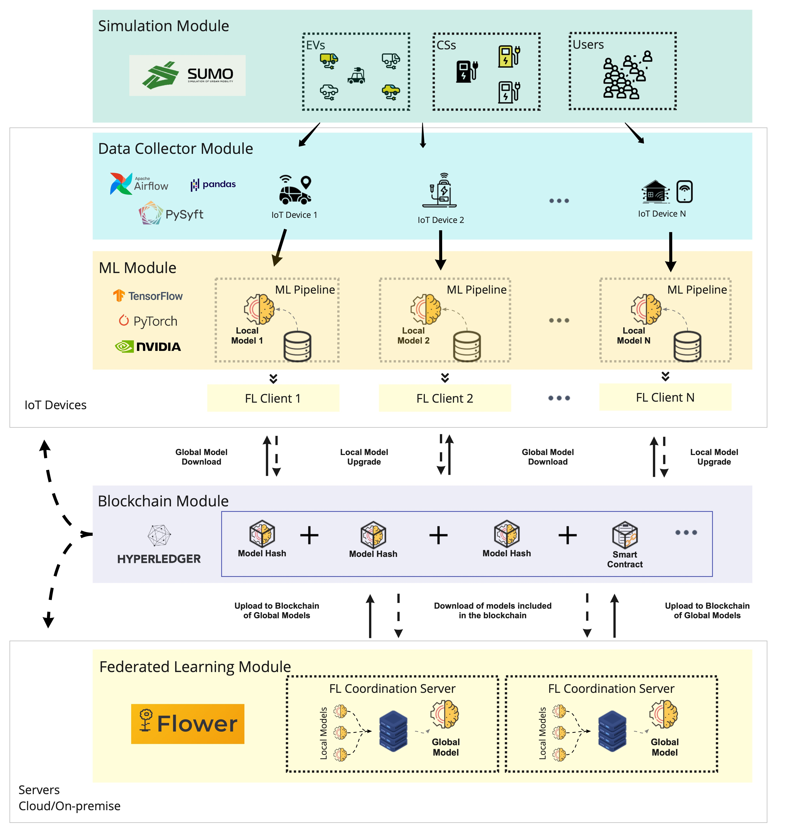






GREEN Architecture

Slide 13
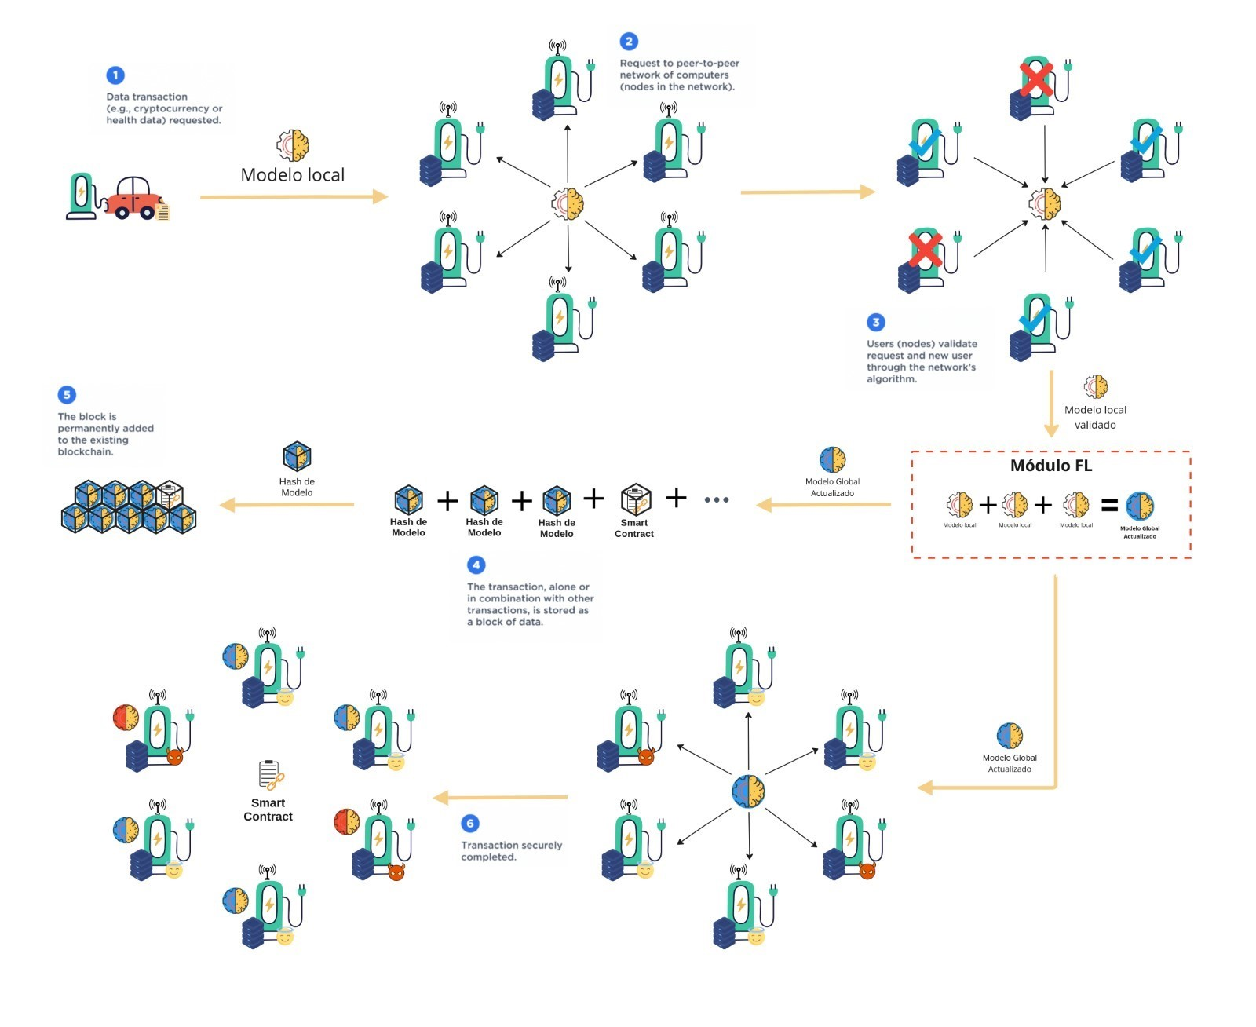
Energy Demand Prediction
Data collection Charging stations collect energy demand data.
1
Model Training Each charging station trains and validates a predictive model.
2
Model Evaluation Each station shares its model and the rest evaluate the quality.
3
Voting Nodes vote on whether to add this update to the global model.
4
Reward or Penalty The Smart Contract provides benefits or penalties.
5

Slide 14
Digital
Twin

Slide 15
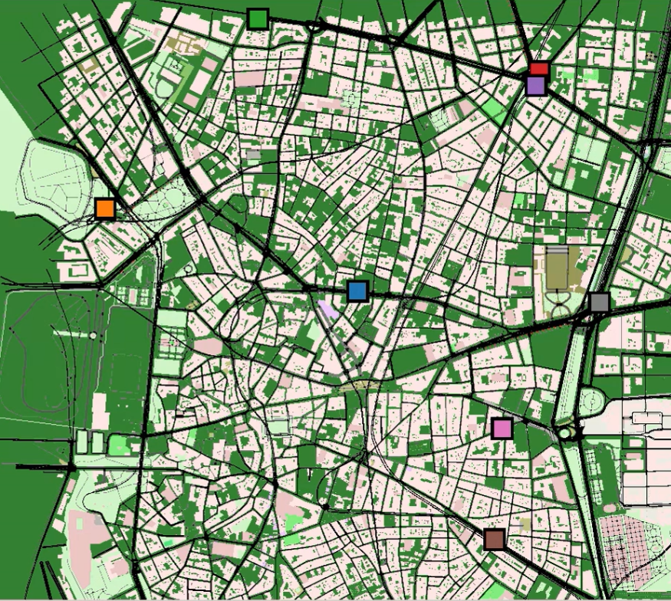
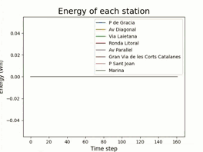
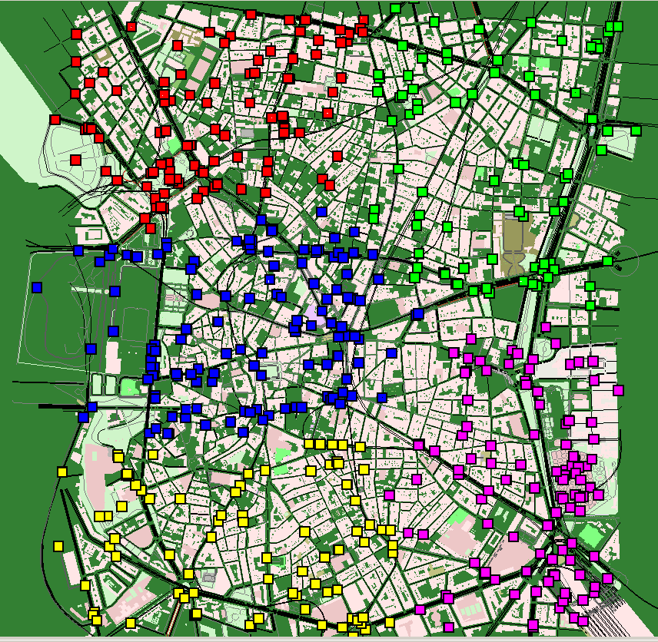
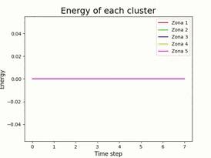
H
INDIVIDUAL
DIGITAL TWIN
For GREEN, a virtual replica is built that simulates and represents the physical environment of a city in real time.
CLUSTERS

Slide 16
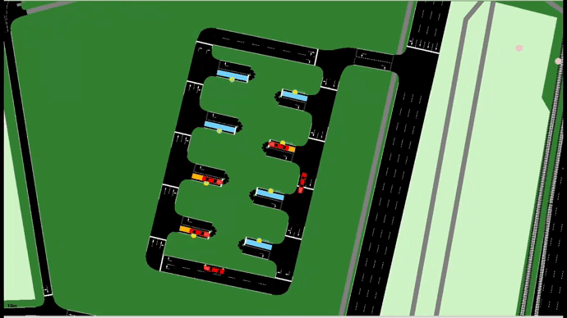
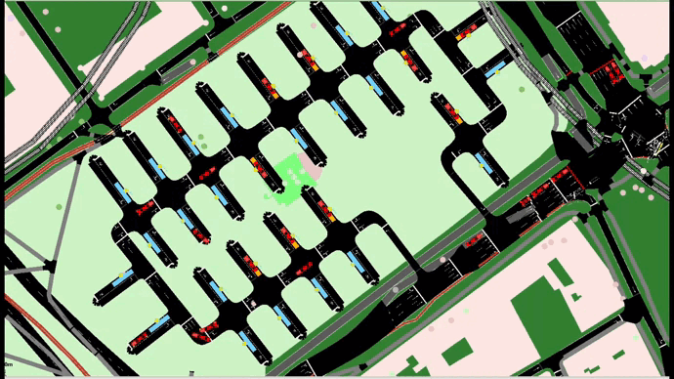
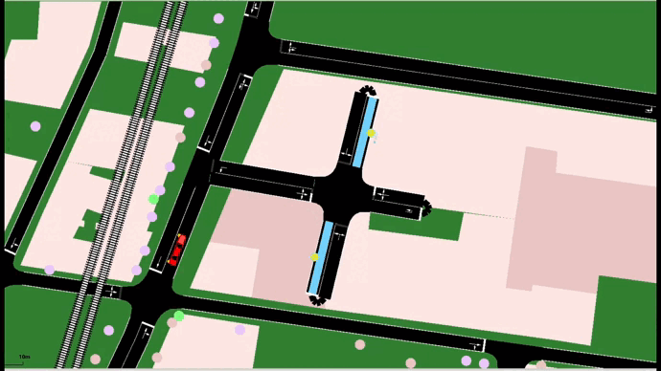
Charging Station Simulation

Slide 17
Real time
Detailed and up-to-date information at any time.
T
Statistical Analysis
2
b
Responsiveness
Long-term and short-term strategic planning.
Evaluate the ability to react to different scenarios.
DIGITAL
TWIN
For GREEN, an accurate and up-to-date virtual representation of the energy ecosystem and its elements in a city is constructed.
Optimisation
e
s
Simulated Scenarios
Better distribution and utilization of assets.
Virtual environments to test strategies.
g
Formation
Train staff without the need for physical access.

Slide 18
Models &
Results

Slide 19
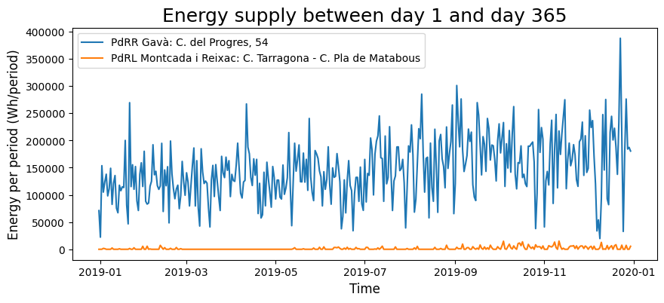
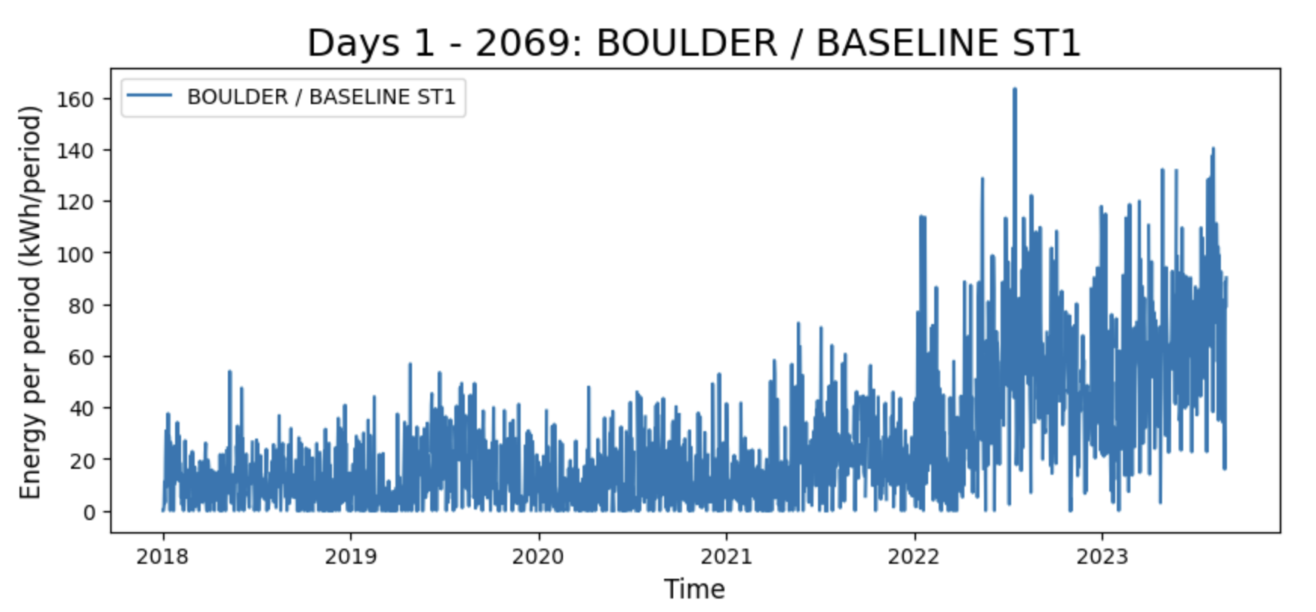
Original Datasets
Barcelona 2019 Contains information on the charge events at the public charging points managed by the municipality in the metropolitan area of Barcelona in 2019
Colorado 2018-2023 Energy use, length of charging time, gasoline savings and greenhouse gas emission reductions from all city-owned electric vehicle (EV) charging stations.

Slide 20
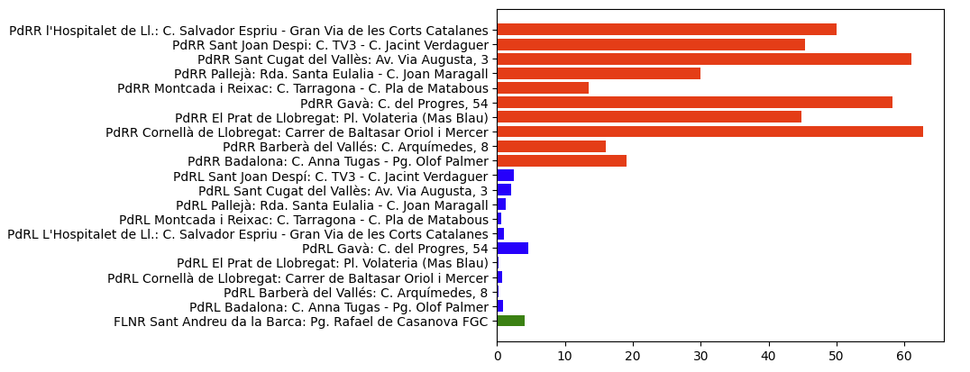
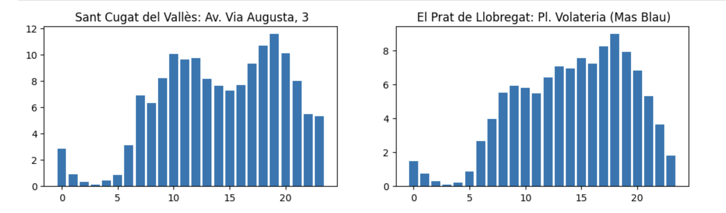
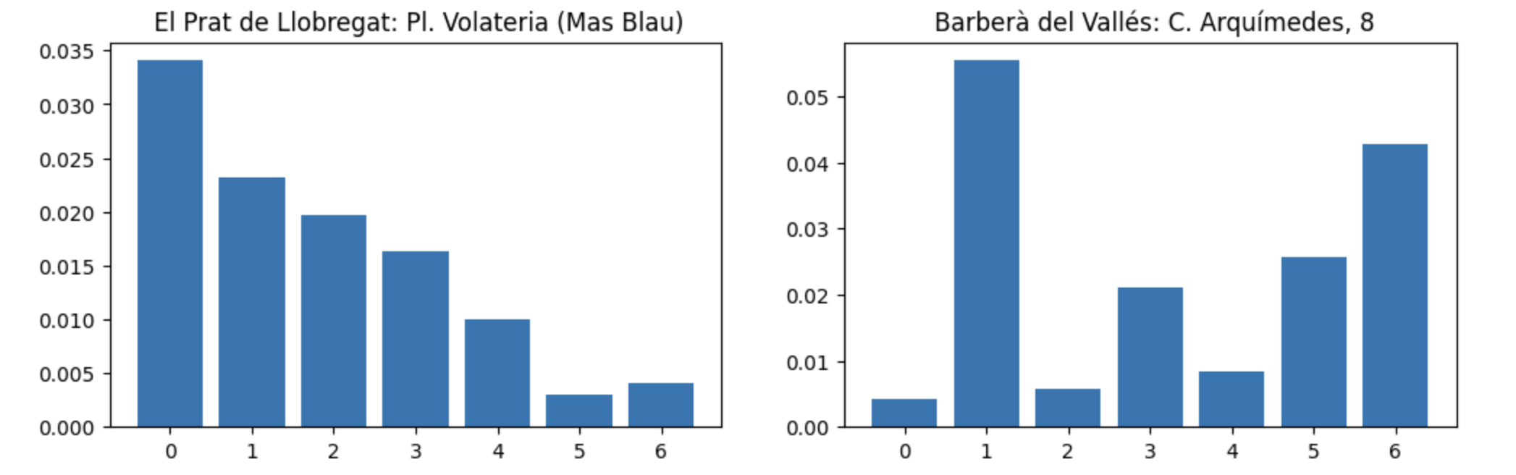
PdRR & PdRL Charging Stations

Slide 21
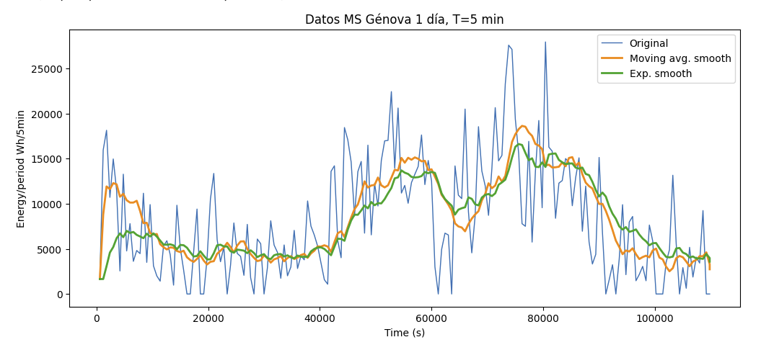
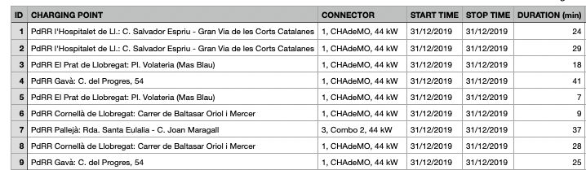
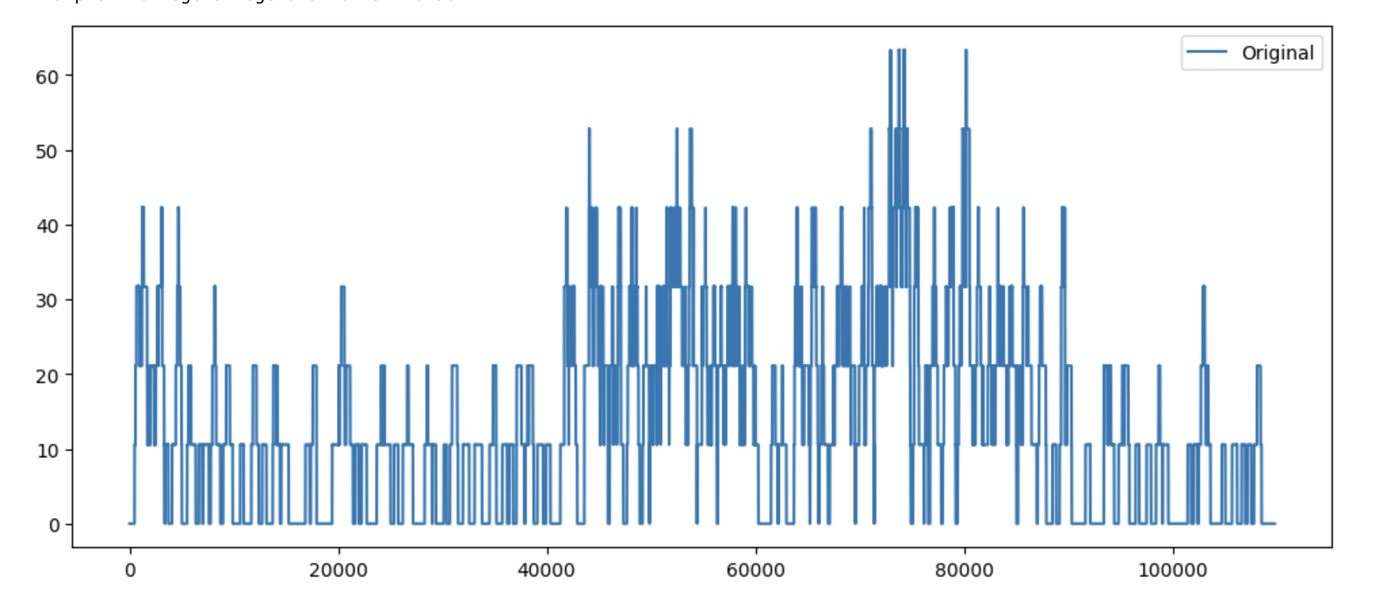
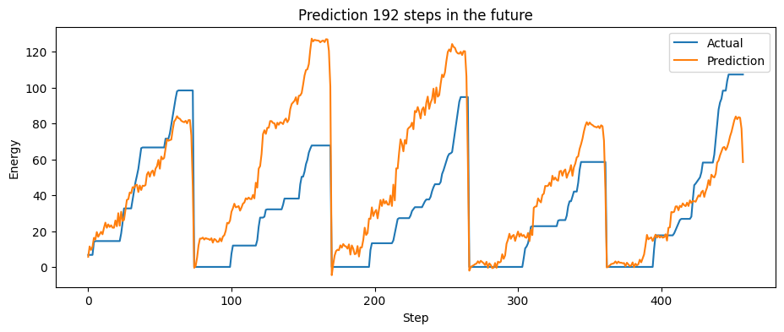
Initial Evaluation

Slide 22
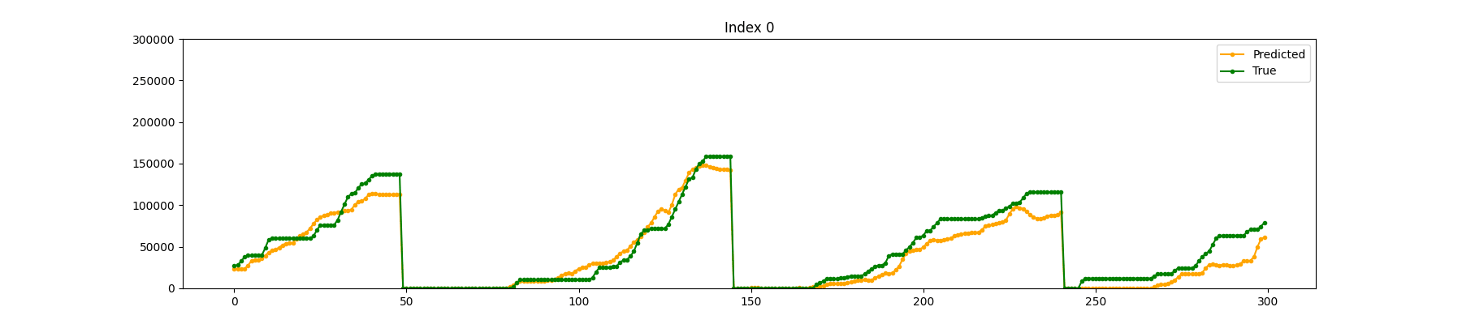
Results
AI models based on Physics-informed Machine Learning are applied. These models incorporate physical principles into their algorithms and will be used to predict energy time series, providing more accurate and efficient results.

Slide 23
Results
AI models based on Physics-informed Machine Learning are applied. These models incorporate physical principles into their algorithms and will be used to predict energy time series, providing more accurate and efficient results.

Slide 24









Variable Configurations
Use of external variables due to the dynamic urban environment
In order to achieve maximum accuracy in the prediction of the energy consumption of charging stations, a careful selection of the inputs that feed our model is made.
Consumption of charging hours
Historical consumption of the CS
Daylight price
Size of the
charging station
Events & Festivities
Climatology
Location of electrical distribution
Geographical location
Month and day of the week

Slide 25
Technology
Combination

Slide 26
Blockchain & Smart Contracts
Secure, private and non-brokered transactions.
Security
Integrity and protection through its decentralized structure.
Immutability
Permanent and sequential recording, making it difficult to alter.
Confidentiality
Cryptographic keys to control and preserve privacy.
Encryption
Cryptographic techniques for securing stored data.

Slide 27
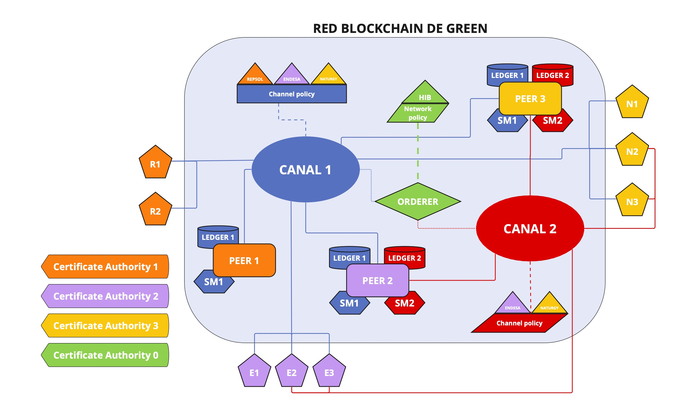
Blockchain Architecture
Use of external variables due to the dynamic urban environment
GREEN Blockchain Network Structures:
Network Policy Ordination Service (ORDERER) 2 channels (fast-slow recharge) 3 Peers (One per organization) Applications of Companies in Channel 1 (Electric Charging Stations) Certifying Authority (GREEN Certifier) Ledger Records (One per Channel) Smart Contracts (One per Channel) HI-IBERIA Organization.

Slide 28
Federated Learning
Collaboration and distribution of model training without the need to share sensitive data in a centralized environment.
Local
Model
Global
Model
Models trained using specific data available from a single particular device.
Models trained using combined or aggregated data from multiple devices or sources.
Improvement
10-20%
Kaissis, G., Rühl, P., Bakula, M., Ziller, A., Passerat-Palmbach, J., Ryffel, T., Makowski, M. (2021). Privacy-Preserving Deep Learning-based Decision Support on Medical Data. *Nature Digital Medicine*.

Slide 29
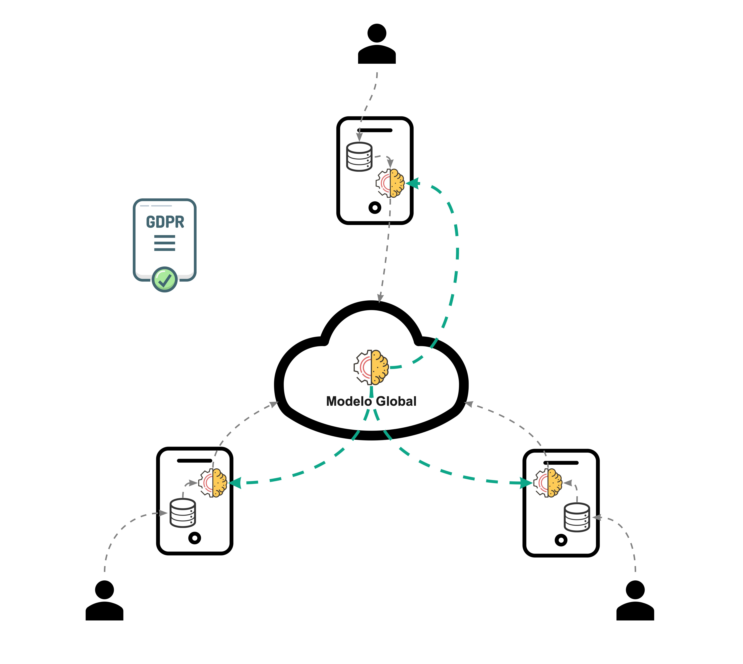
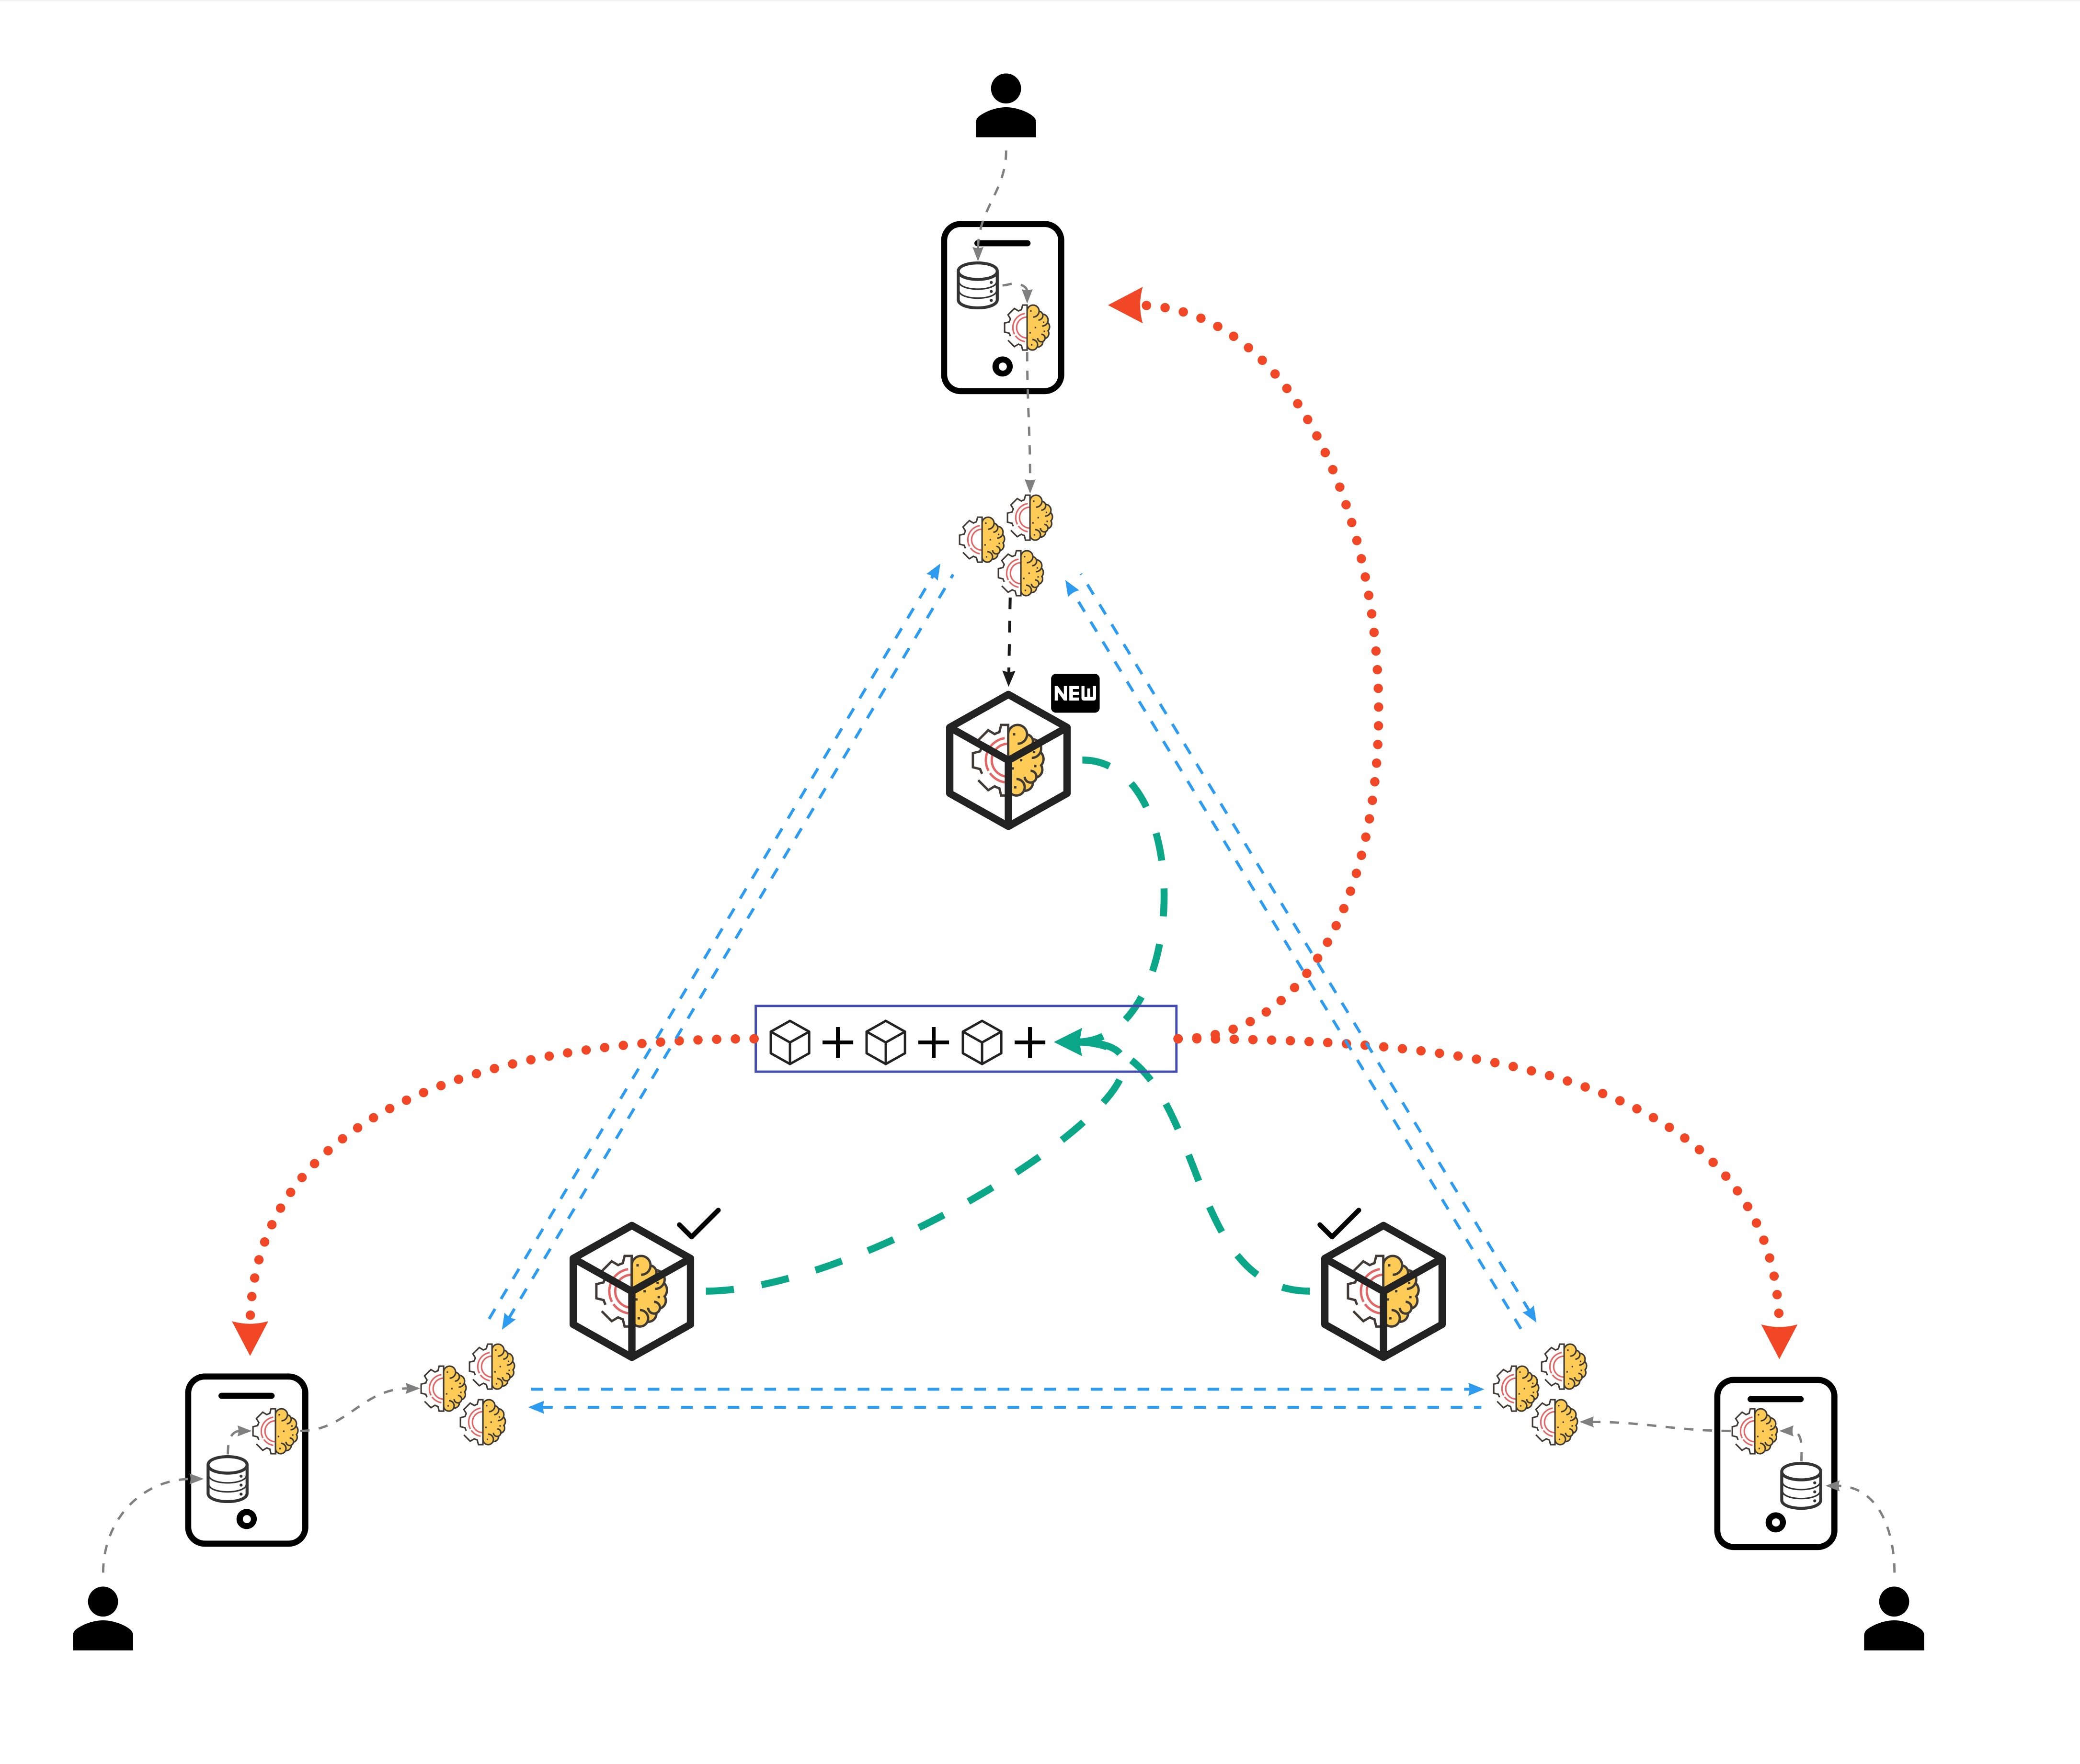
Technology Combination
Federated Learning, Blockchain & Smart Contracts.
Traditional FL Structure
Centralized, centrally authoritative data.
BC&FL structure
Decentralized approach, data is handled through the BC network.

Slide 30
The Future

Slide 31
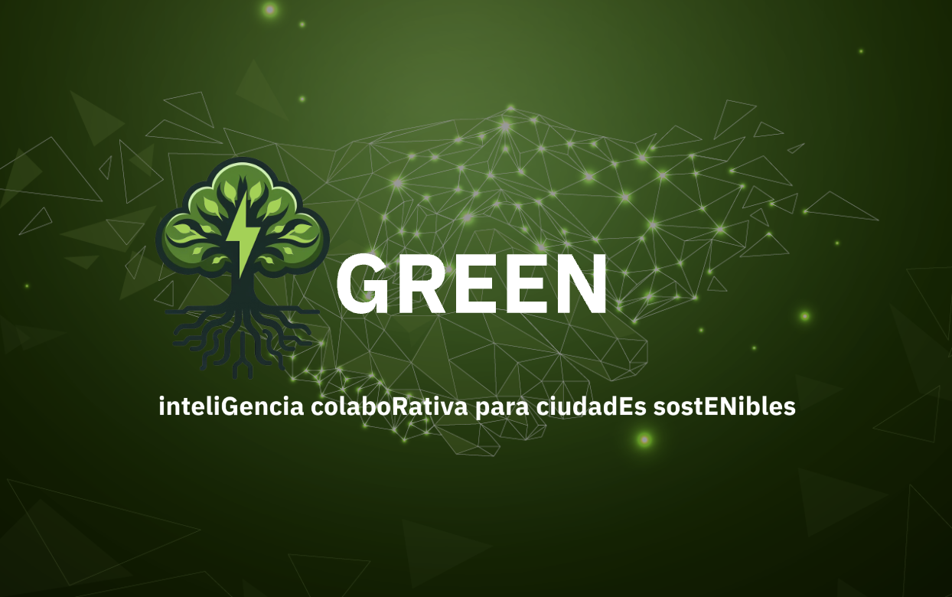

GREEN Interface
Optimized user experience
Map of Charging Stations
Visualize in real time the geographical distribution of charging stations for electric vehicles.
Connection with APIs
Integrates data from various APIs, enabling interoperability and improving operational decision-making.
Access to Blockchain
It provides secure and transparent access to a blockchain network.
I
July 2024
Say hello to the future.

Slide 32


Slide 33
Applications
Technological Innovation in the Energy Environment
x
Decision Making
Detailed information allowing you to evaluate the impact of decisions before implementing them
Recharge Prevention
Anticipate demand in different areas of the city, optimising the distribution of resources.
0
c
Audits
Virtual reports to ensure the status and availability of resources.
Time reduction
It improves the user experience, increases the adoption of electric vehicles and contributes to urban sustainability.
G

Slide 34
Benefits
Strategic Value
d
Operational Efficiency
Agility in operations and more efficient execution of tasks and missions.
g
Provisioning &
Constant Availability
Ensures business continuity and minimizes operational disruptions.
The implementation of these technological solutions in the energy field has provided a series of holistic and cross-cutting benefits.
s
Cost Reduction
Process optimization and loss prevention with financial objectives.
a
Effective Resource Allocation
Effective distribution and use of available resources.

Slide 35
Not only a SOLUTION;
It’s a TRASFORMATION

Slide 36
Technological Solution
g
(
a
f
T
Federated
Learning
x
Blockchain
Smart
Contracts
P
s
I
The combination of these technologies strengthens operational efficiencies and enables more accurate decision-making backed by real-time data.

Slide 37
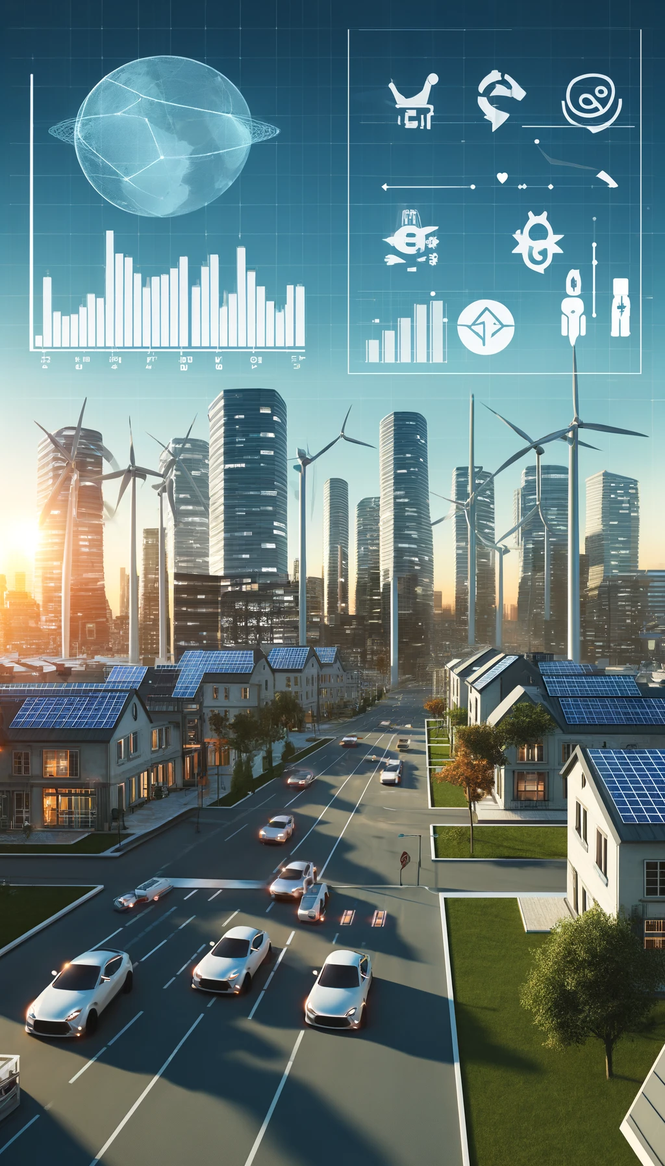



Other Use Cases
GREEN is not simply a solution; it is a transformation. ​

Slide 38
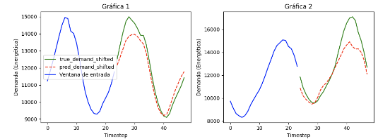
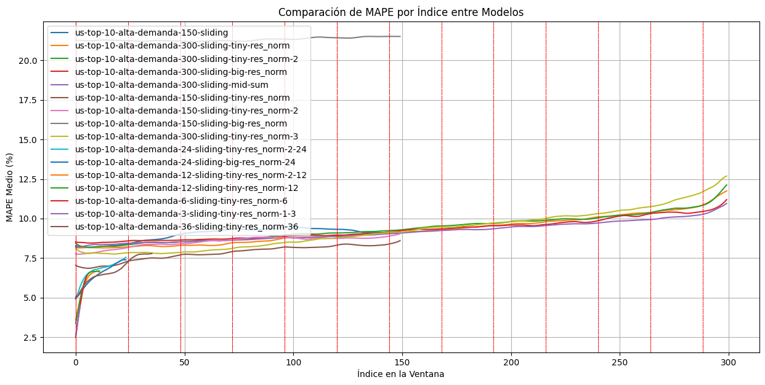
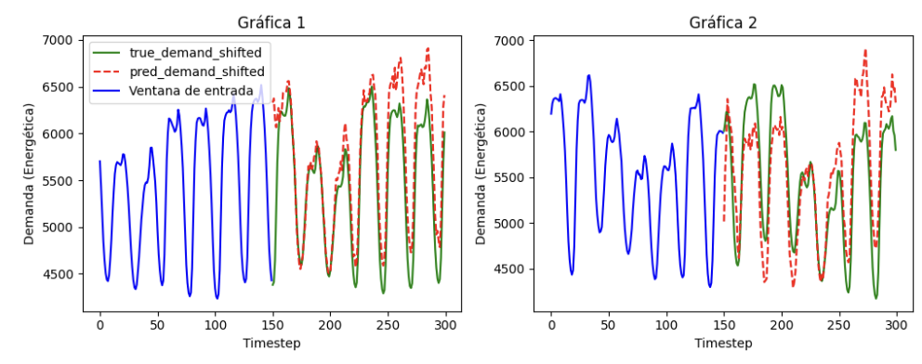
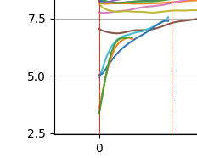
City Energy Prediction

Slide 39
Collaboration
Strengthening Bonds for Success
Immutability
The Guarantee of Data Integrity
03
02
Privacy
Confidentiality of Information
Conclusions
Key Reflections for Industrial Innovation
01

Slide 40







Contact us at
AI Engineer: Sergio Zaera Mata
(szaera@hi-iberia.es)
AI Director: Roberto Gómez-Espinosa Martín
(robertogemartin@hi-iberia.es)​
CEO: Juan Alberto Vecino​
(jvecino@hi-iberia.es)

